Slide 1
The interplay of orexin and corticotropin-releasing factor neurocircuitries in drug-seeking behavior
BIOL 792: Brain Stress Circuities: Orexin Connections
Brylie Hartwig | March 27th, 2024

Slide 2
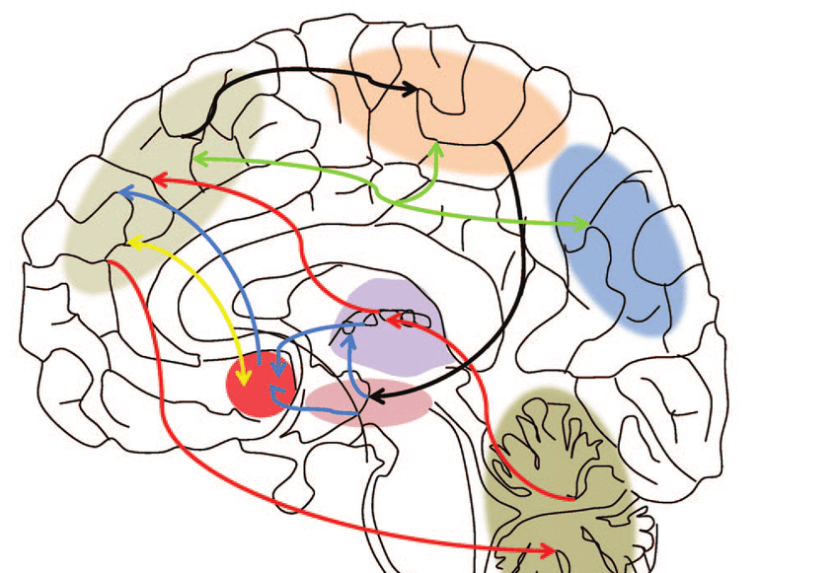
Neurocircuits in the brain activated by stress/reward mediate drug-seeking behavior and withdrawal N
theme
Comprehending these circuits and the underlying neurobiological mechanisms provides clarity regarding the components underpinning drug addiction and the various behaviors it induces

Slide 3
Main characters
Orexin (Orx) / Hypocretin
Neuropeptide in brain that regulates various physiological processes
Paraventricular nucleus of the thalamus (PVT)
Relay station that regulates arousal, attention, and stress responses
Corticotropin-releasing factor (CRF or CRH)
Neuropeptide involved the brain stress circuit

Slide 4
Addiction
Compulsive
Chronic
Physiological
Psychological
Need for a substance, behavior, or activity

Slide 5
Prevalence of Drug Addiction
2019
20.4 million diagnosed with a SUD
10.3% received SUD treatment
2020
40.3 million diagnosed with SUD
6.5% received SUD treatment
107,000 died from drug overdose
92,000 died from drug overdoses

Slide 6
Why use drugs
Experience pleasure
Addiction
Reduce Stress
Social influence
Hijacks brain's natural reward system
Influences stress circuit
Alters neurotransmitter levels

Slide 7
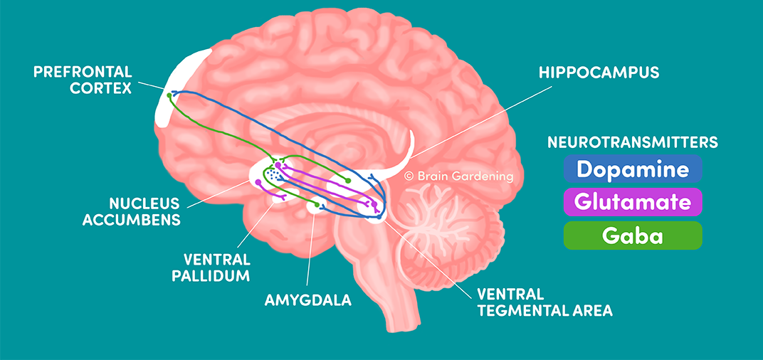
Brain Reward Circuitry
Corticostriatal brain reward circuit
Regulates:
Motivated Behavior
Learning
Emotions

Slide 8
Drugs Effects on Brain reward circuitry
Neuroadaptations in corticostriatal brain reward circuit
Increases in dopamine = brain less responsive to natural rewards
drive drug seeking

Slide 9
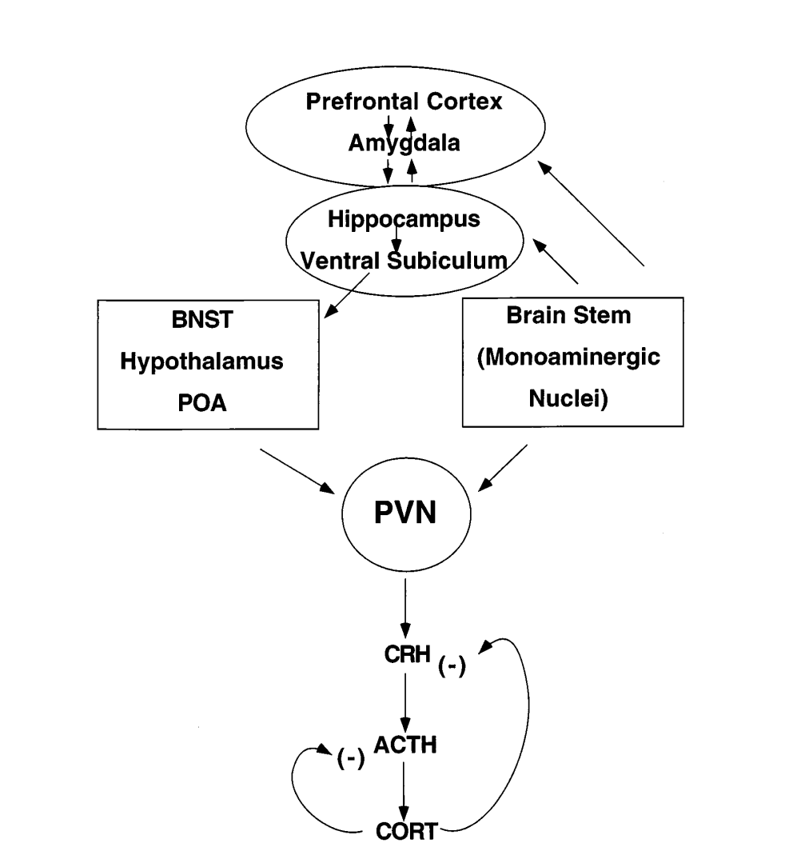
Brain Stress Neurocircuitry
HPA axis
Interconnected network of brain regions
Regulate behavioral and physiological responses to stress
Prefrontal Cortex= PFC
Bed Nucleus of the Stria Terminalis= BNST
Locus Coeruleus= LC

Slide 10
Drugs Effects on Brain Stress Neurocircuitry
Acute Effects
Chronic Effects
Withdrawal Effects
Hyperactivity of HPA axis
Comorbid with stress-related disorders
Release of cortisol
Hyperactivity of HPA axis
Stress-induced
drug-seeking
Orexin plays a role in stress and reward!

Slide 11
Orexins/ Hypocretins
Neuropeptide
OrxA and OrxB
Produced in the lateral hypothalamus (LH)
Roles in:
Wakefulness/Arousal
Affect/Motivation/Reward
Stress states
Includes projections to various regions in the brain

Slide 12
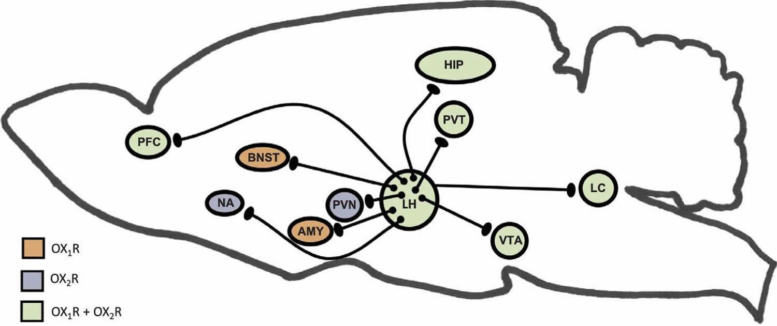
Orexin's role in reward and stress circuitry
Paraventricular nucleus= PVN
Nucleus Accumbens = NA
Ventral tegmental area = VTA
Note projections to CeA, VTA, and PVT
Cocaine influences release of Orx

Slide 13
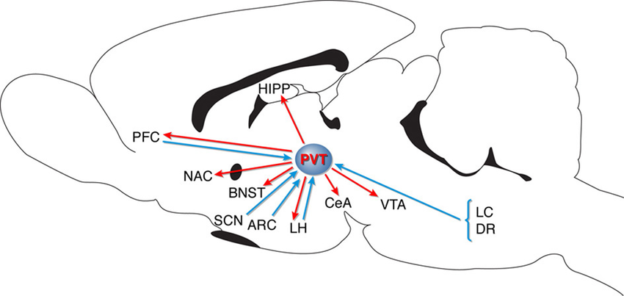
Paraventricular nucleus of the thalamus (PVT)= Relay Station
LH
PVT
CeA, BNST, NaC, VTA
Orx reward-related communication

Slide 14
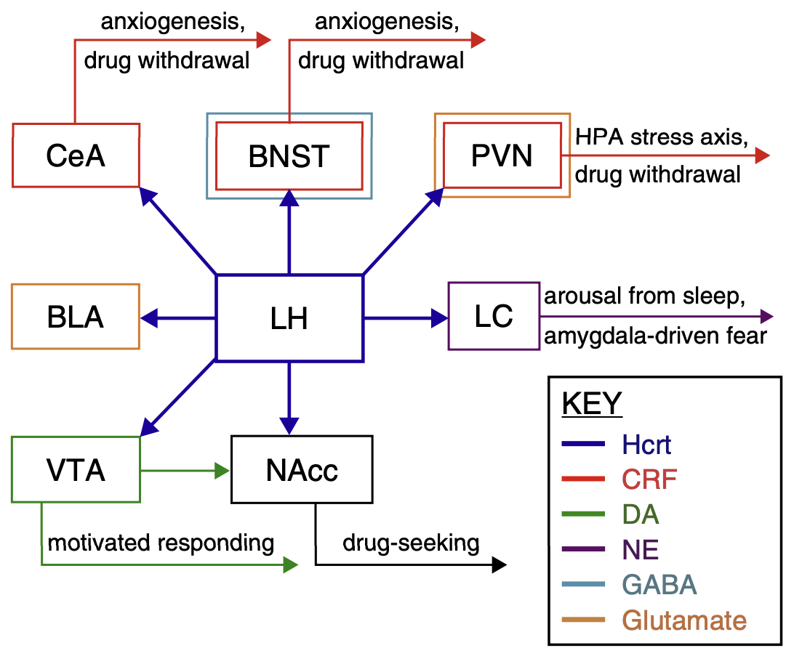
CRF connections to systems
Corticotropin-releasing hormone (CRF/CRH)
Stress circuit involvement
CRF1 vs CRF2

Slide 15
CRF Projections from Limbic Forebrain to VTA
Double Labeling:
BNST
CeA
PVN

Slide 16
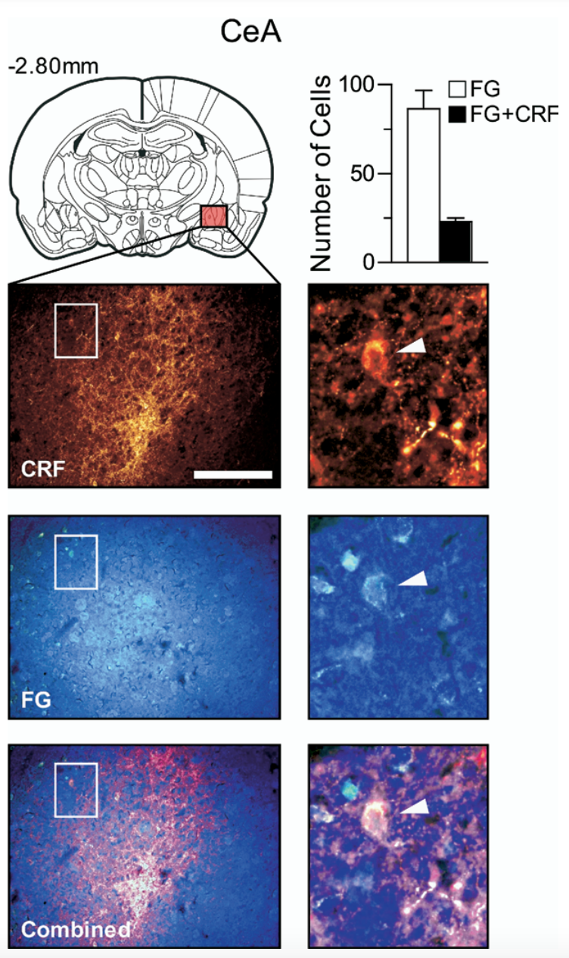
CRF Labeling in the CeA
VTA receive projections from BNST, CeA, and PVN
Influences DA release

Slide 17
Orexin relation to specific types of substance abuse

Slide 18
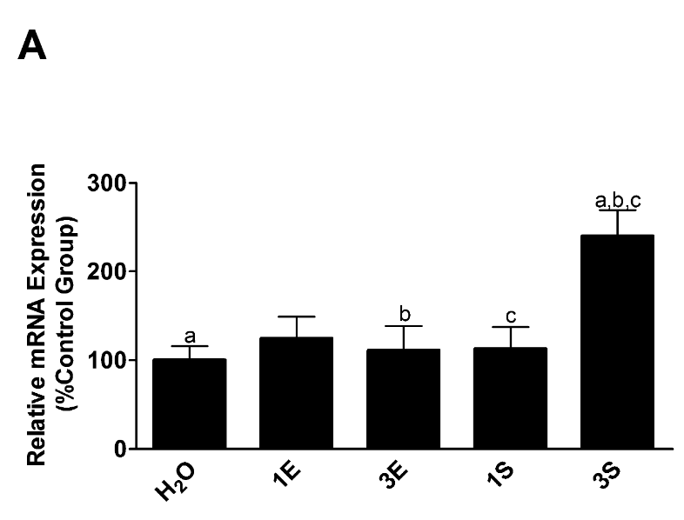
Binge drinking increases Orx Production
Pre-pro orexin mRNA Expression
E= Ethanol
S= Sucrose
Binge-like EtOH = increased signaling of hypothalamic Orx neurons

Slide 19
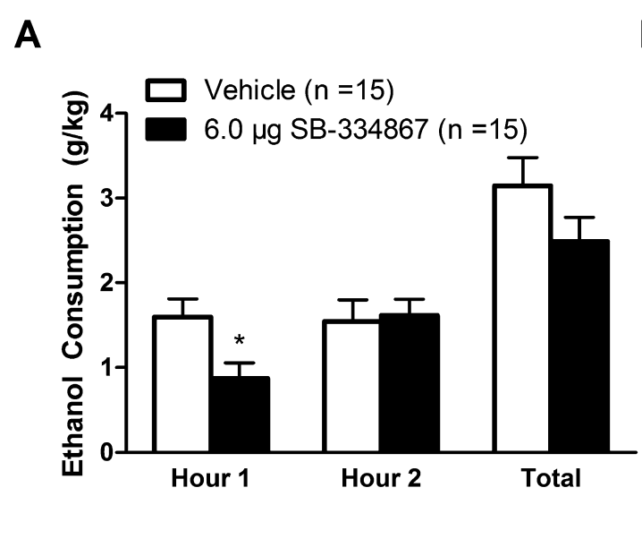
Blocking Orx₁R in the CeA blocks binge-like ethanol drinking
Use of Orx1R antagonist SB-334867 in CeA

Slide 20
Blocking Orx₁R in the VTA blocks binge-like ethanol drinking
Use of Orx1R antagonist SB-334867 in VTA

Slide 21
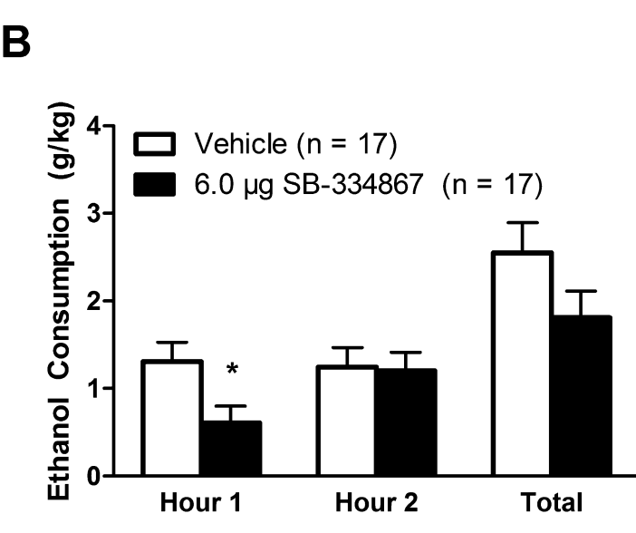
Blocking Orx₁R inhibits binge-like ethanol drinking
CeA
VTA
Blocks binge-like drinking in first hour
short half-life

Slide 22
Blocking Orx₂R in CeA prevents increase in binge-like ethanol drinking
Use of Orx2R antagonist TCS-OX2-29 in CeA
Blockage of OrxR₂ influences binge-drinking behavior??
Prevents in EtOH consumption??

Slide 23
Blocking Orx₂R in VTA does not influence binge-like ethanol drinking
Use of Orx2R antagonist TCS-OX2-29 in VTA
OrxR inhibition did not influence binge-like sucrose drinking
Orx₁R mediates drug-seeking effects in VTA

Slide 24
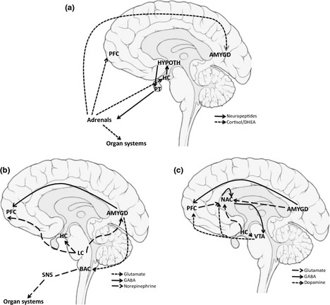
What is known
Stress and reward circuitries contain interconnected regions
Addiction influences both stress and reward

Slide 25
What is known
+Orx
+CRF

Slide 26
What isn't known
Specific circuit/molecular modulators control drug-seeking behavior
What specific mechanisms are utilized
What areas of the brain are utilized

Slide 27
What the Problem Is
Prevalence of addiction
Unknown circuitry interaction
Interaction between Orx and CRF systems
Modulators employed
2x increase in diagnosis

Slide 28
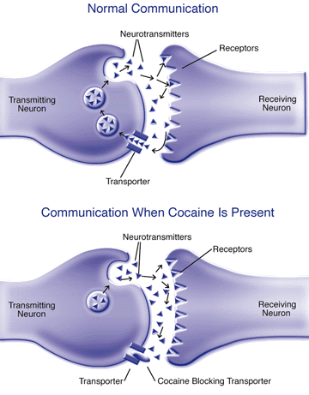
What the Problem Is
Neuroplasticity
Individual differences
Desensitization of reward pathway
Increase in dopamine release
Chronic use alters synaptic connections
Male vs female

Slide 29
Why we care
Development of drug addiction treatments
Enhance knowledge
Of mechanisms of action
Identify potential therapeutic targets
Of neural circuitry

Slide 30
My hypothesis
Orx and CRF work bidirectionally within stress/reward circuits to influence drug-seeking behaviors

Slide 31
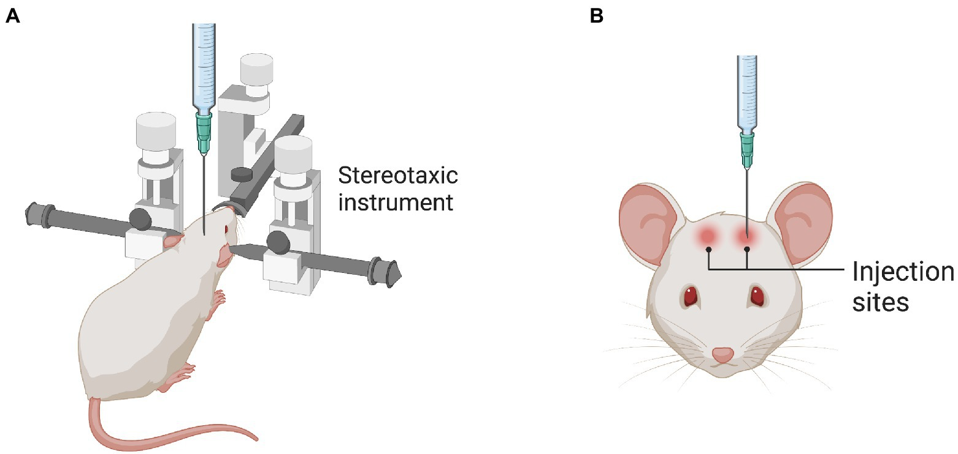
Methods
brain activation patterns in C-LA rats
Self-administration training
6 hours daily
Cannula placed in pPVT
C-LA = cocaine long access

Slide 32
Methods
Brain activation patterns in C-LA rats
Fos mapping in pPVT, BNST, CeA, prelimbic cortex, infralimbic cortex, nucleus accumbens, and basolateral amygdala

Slide 33
Results
Brain activation patterns in C-LA rats
Cocaine long-access self-administration over 21 days
22 out of 29; 79% responded to cocaine
C-LA rats acquired cocaine self-administration

Slide 34
Results
subset
Brain activation patterns in C-LA rats
OrxA reinstated cocaine-seeking behavior

Slide 35
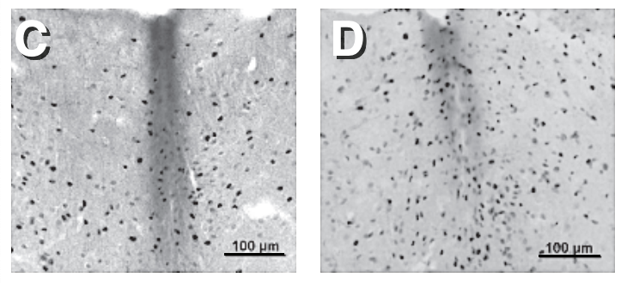
Results
Brain activation patterns in C-LA rats
pPVT
CeA

Slide 36
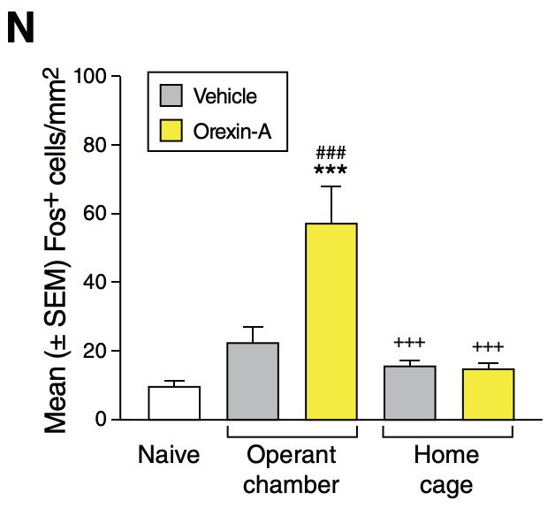
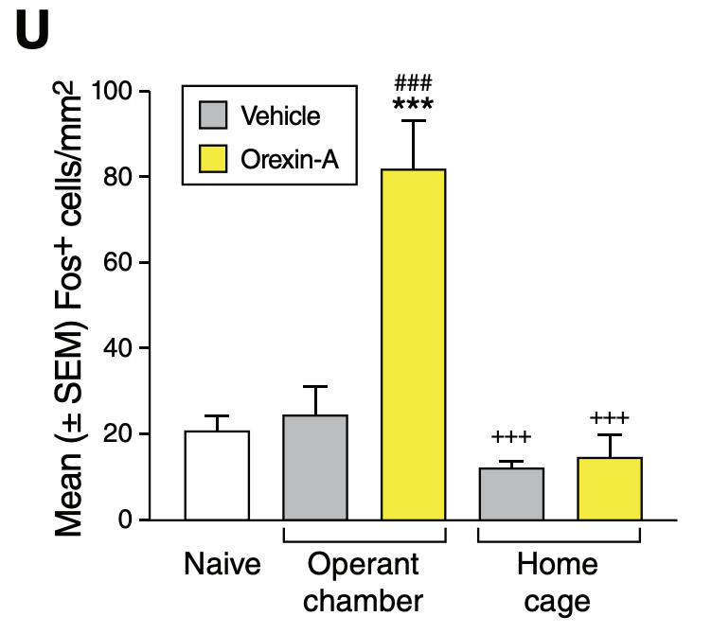
Results
Brain activation patterns in C-LA rats
pPVT
BNST
CeA
pPVT has projections to BNST and CeA

Slide 37
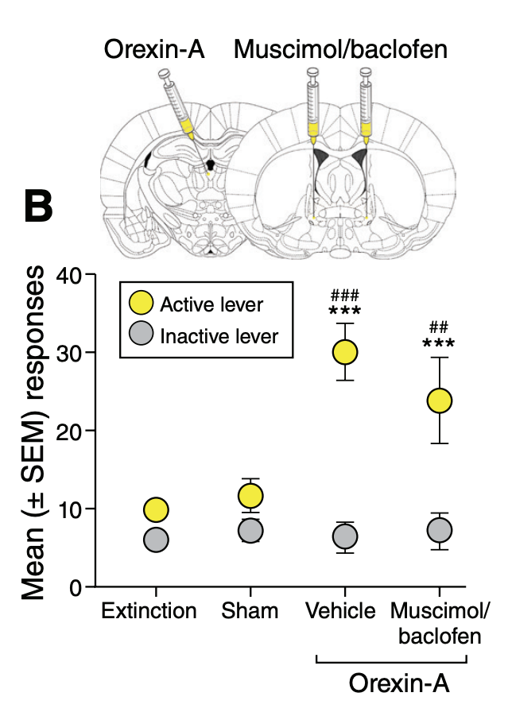
Results
BNST
Inactivation of the BNST and CeA in C-LA rats
Muscimol/baclofen used in inactivation
BNST does NOT influence the reinstatement of cocaine seeking

Slide 38
Results
CeA
Inactivation of the BNST and CeA in C-LA rats
CeA DOES influence the reinstatement of cocaine seeking

Slide 39
Results
Short-term access to cocaine
Orx influences cocaine-seeking in both C-SA and C-LA rats

Slide 40
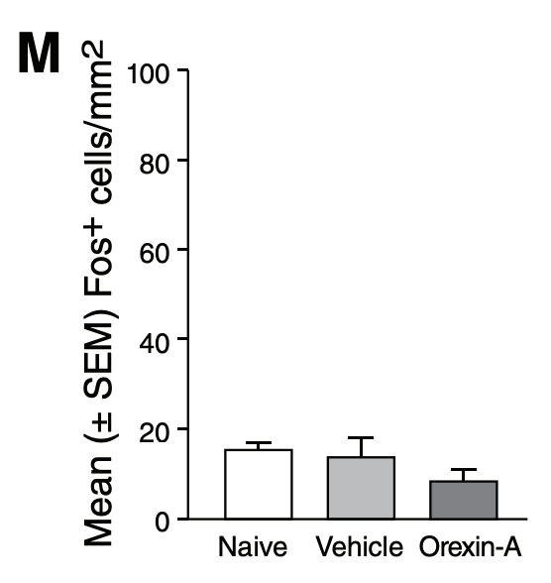
Results
pPVT
Short-term access to cocaine
CeA
C-SA utilize different pathway compared to C-LA

Slide 41
Results
Access to sweetened condensed milk
Orx influences reward-seeking

Slide 42
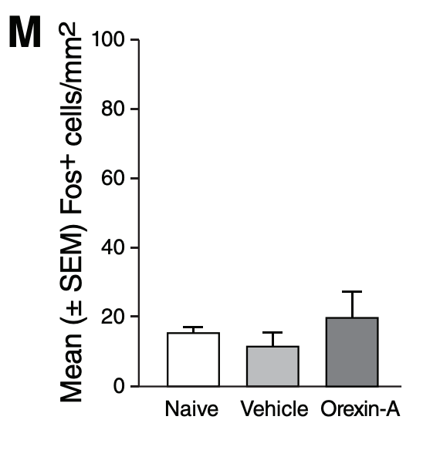
Results
pPVT
Access to sweetened condensed milk
CeA
Sweetened condensed milk utilizes different pathway compared to C-LA

Slide 43
Results
Effects of CRF1 receptor blockade in the CeA
CRF1 receptor antagonist CP154526 used
Blockade of CRF1R prevents cocaine seeking behavior
Orx and CRF activation work together to influence drug-seeking behavior

Slide 44
Conclusion
blocking of CRFR1 in the CeA prevents the reinstatement of cocaine-seeking behavior induced by the administration of OrxA in the pPVT

Slide 45
Take Home Messages
Stress activates OrxA in PVT contribute to relapse
Orx1R and CRF1 in the CeA contribute to relapse
PVT and CeA are connected
CRF neurons in CeA project to VTA = stress activates motivational systems
Orx signaling contributes to reward seeking

Slide 46
Future Studies
Perform study on female rats
Assess sex-specific differences
Assess other stimulants
Amphetamine, methamphetamine, nicotine

Slide 47
Thank you

